Slide 1


Intelligent Health - Lets Chat

Slide 2

Agenda
Chatbot Demonstration
Population Health Assistant
Predicting Disease
Sharing Research
New Insights
Syndromic Surveillance

Slide 3

Ask ANY Question

Slide 4

PRiVATE DATA STAYS PRIVATE
HIPPA Compliance
Ethical Guardrails

Slide 5
Rediscover YOUR DATA
Keep Private Insights Private

Slide 6
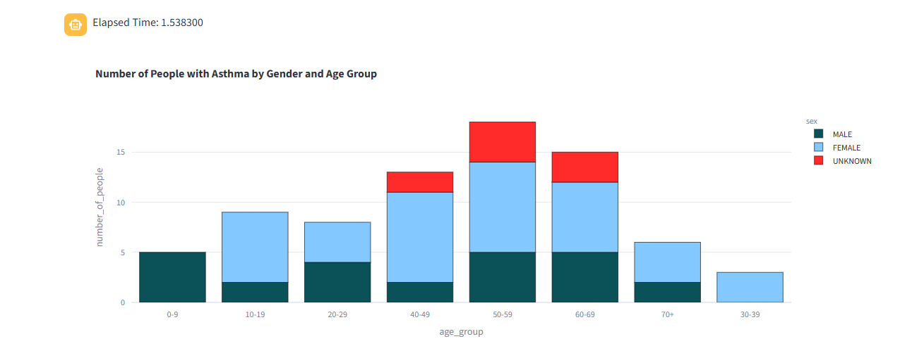

Slide 7
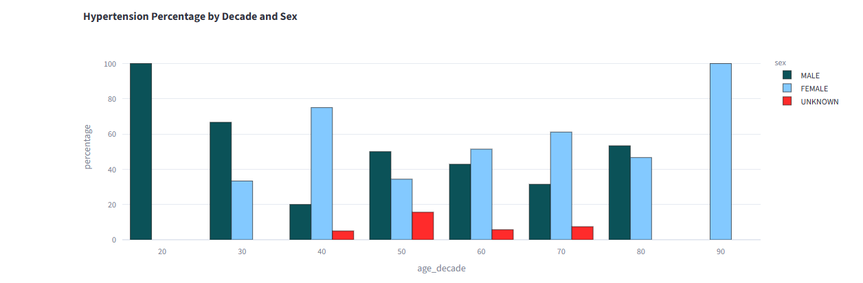
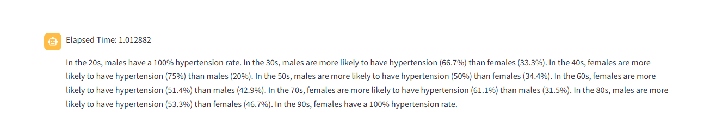

Slide 8
For Public Health Officials
A private LLM empowers public health officials and researchers by revealing emerging trends and patterns in population health while maintaining strict data security. By identifying risks such as rising disease incidence, health inequities, or community-level vulnerabilities, it enables earlier intervention and smarter allocation of resources. This insight helps guide evidence-based policy, research priorities, and targeted programs that improve outcomes and protect communities.

Slide 9
For Physicians
A private LLM helps physicians uncover gaps in care and risk-stratify patients across their entire panel while keeping sensitive health data secure. By highlighting which patients are at greatest risk or missing essential preventive services, it enables proactive outreach and timely intervention. This intelligence supports better clinical decision-making, improves outcomes across the patient population, and strengthens continuity of care.

Slide 10
For THE COMMUNITY
WellTellai is your trusted health assistant that helps you discover what care is available in your region and which treatments are working best. By pointing you toward proven best practices and highlighting community health insights, it makes complex information easy to understand. You can ask WellTellai anything—so you feel informed, supported, and empowered to make the best decisions for yourself and your community.

Slide 11
For DATA Scientists
WellTellai empowers data scientists by turning natural language questions directly into SQL, delivering rapid, precise answers from complex datasets. Beyond query translation, the platform includes advanced data science “magic functions” like PCA, feature reduction, and descriptive statistics to accelerate analysis. WellTellai also proposes follow-up research questions and suggests the next scientific methods to apply, helping you move faster from data to discovery.

Slide 12
For REGIONAL HEALTH Organizations
WellTellai enables regional health organizations to use natural language to perform advanced tasks such as epidemiology studies and community needs assessments without requiring specialized coding expertise. By integrating machine learning and other advanced analytic techniques that are typically costly, it helps uncover trends, risks, and opportunities for targeted interventions. This keeps organizations technologically advanced, under budget, and better equipped to serve the health needs of their communities.

